Slide 1

PROJECT OUI
Group: IC-INF-IT1D
Date: 4/11/2024
Main speakers:
Carlos Schaap García
Rafael Margarido Correia

Slide 2
Presentation structure
Team introduction
About the project
Website structure
Exploring the website
Conclusion
Questions?
Expected presentation time: 10-15 minutes

Slide 3
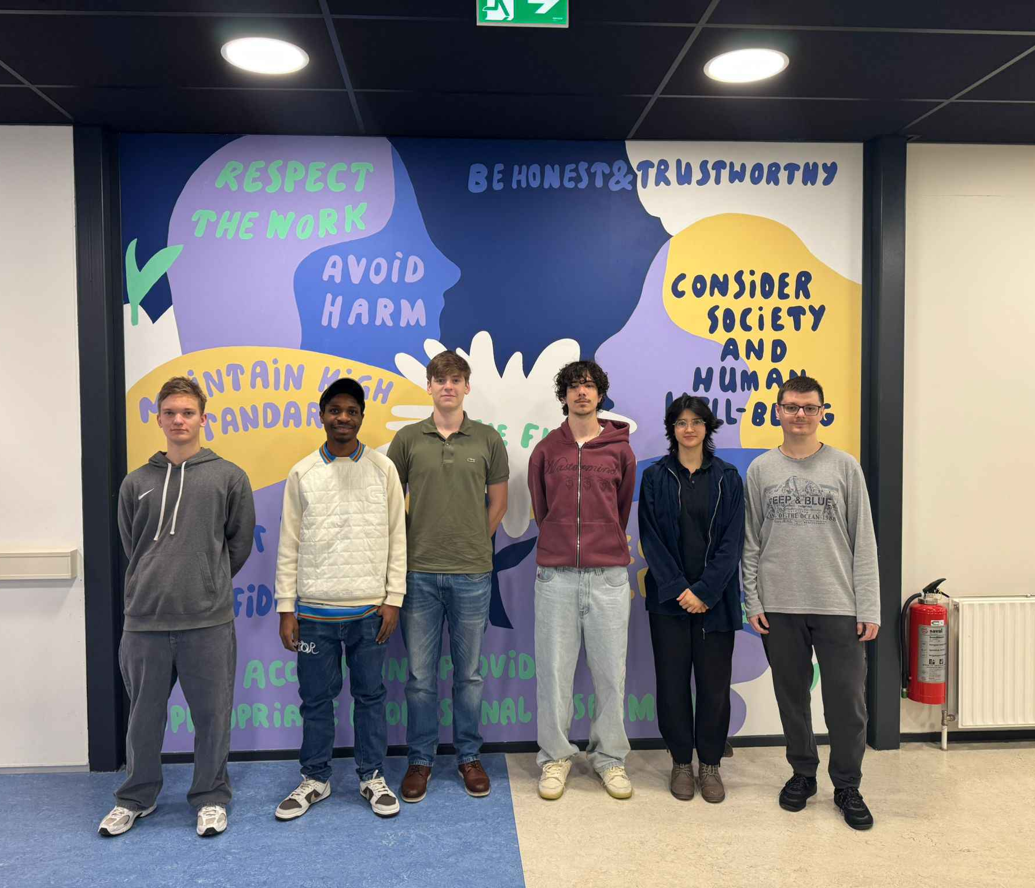
The Team
Nick Grahovskis
Ugochukwu Joseph Ndiogazili
Carlos Schaap García
Rafael Margarido Correia
Miriam Cerulíková
David Corodeanu Cristian

Slide 4

About the project
Client: OUI Coffee Shop, owned by Lionel Smith, located in the Netherlands.
Visual expectations: A minimalistic, vibrant and French styled website.
The goal: Create a unique website for the coffee shop to attract mainly young adults (ages 18-30).

Slide 5

Website Structure
Sticky Navigation Bar: Stays at the top as you scroll
Main Page: Simple and elegant.
About Us: Explains why to choose us.
Menu: List of available items.
Events: Shows upcoming events and parties.
Reviews: See customer feedback.
Feedback: Add your own feedback.
Table Booking: Easy online reservations.
Footer: Contact and location info.

Slide 6
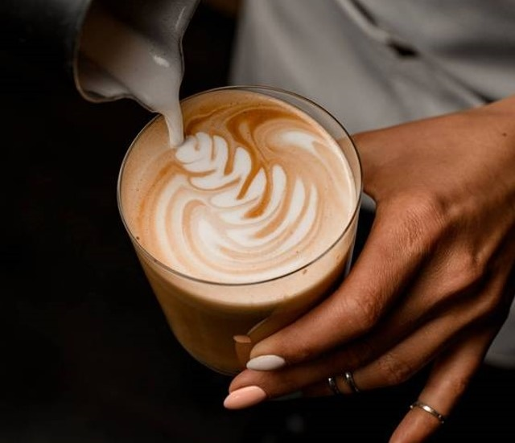
LET’S GET TO THE WEBSITE

Slide 7
Conclusion
The OUI Coffee Shop website is important for propagation and communication with customers.
The website targets young adults according to the clients' requirements.
The website has a minimalistic structure and features which encourages people to visit the shop.

Slide 8
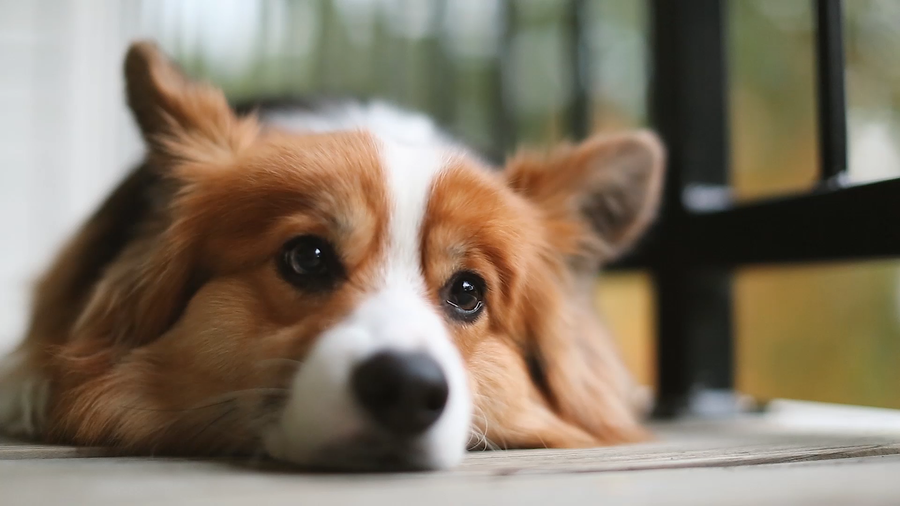
<>QUESTIONS?</>

Slide 9
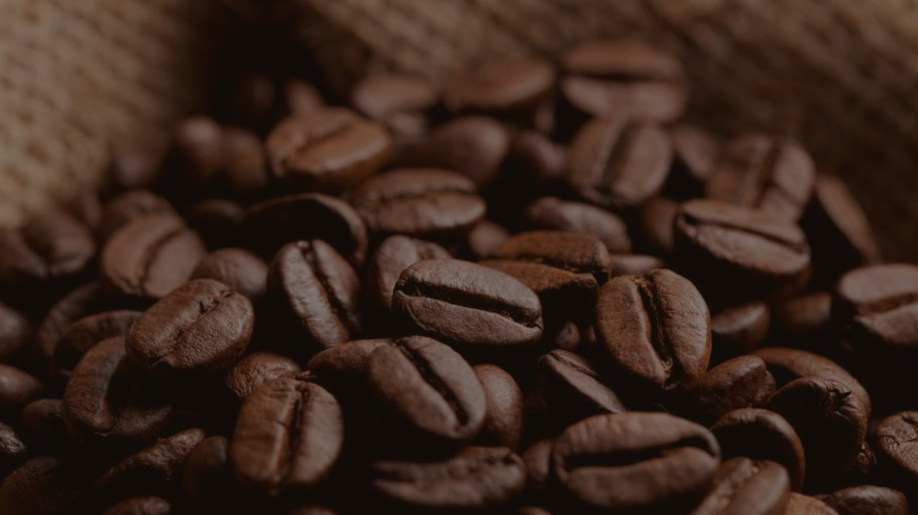
Thank you for your time

